Slide 1
Accelerate development of SPFx solutions with PnP reusable controls and frameworks
Joel Rodrigues
Notes:
This slide is mandatory. Please do not remove.

Slide 2

Joel Rodrigues
Development Consultant
Corporate Project Solutions
https://joelfmrodrigues.wordpress.com/
@JoelFMRodrigues
I'm a big SharePoint and Office 365 development enthusiast!

Slide 3
Notes:
This slide is mandatory. Please do not remove and try to use it during Q&A at the end of your session. Thank you!

Slide 4
WiFi Keys for Attendees
Connect to the wireless network MSFT_GUEST
Login details for the wireless network:
Guest Username O365Sat@outlook.com
Guest Password: 0195

Slide 5
Reusable controls (React)
Reusable property pane controls (React)
PnPJS library
Demo
Agenda

Slide 6
A few minutes ago, in a office not that far away…a developer was writing the same code he did last week

Slide 7
Reusable controls
Reusable React controls for SharePoint Framework solutions

Slide 8
Common project requirements
Use Office UI Fabric
Rich user experience
Used in pages (content)
Very simple to configure and use
Extensible events
Open source
“SharePoint-aware”
Reusable controls

Slide 9
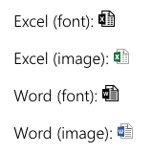
FileTypeIcon
Returns the file type icon based on a specified file path or application.

Slide 10
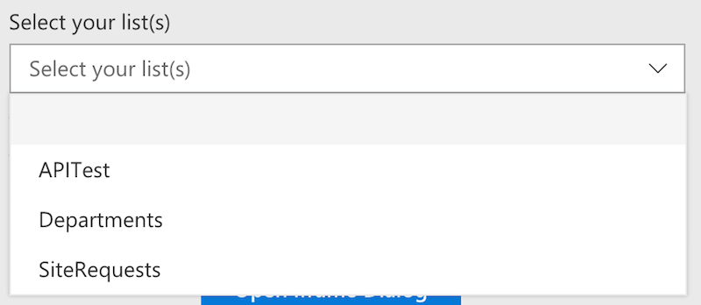
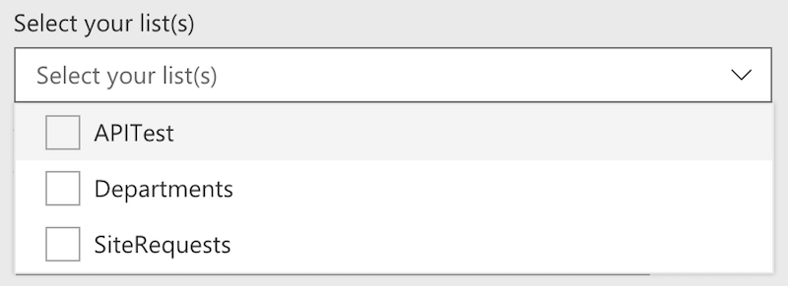
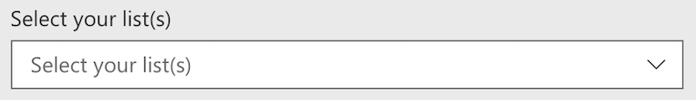
ListPicker
Allows you to select one or multiple available lists/libraries of the current site.

Slide 11
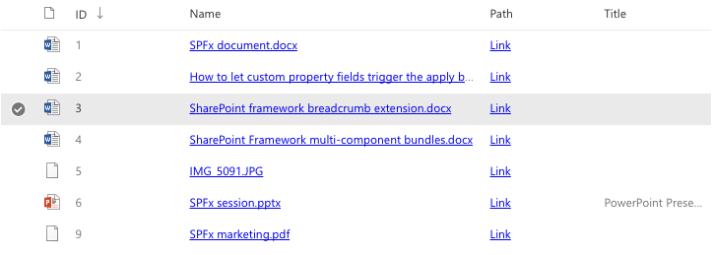
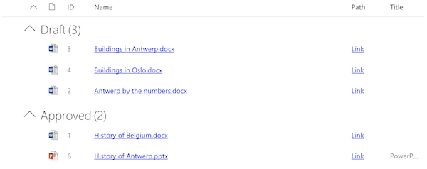
ListView
Renders a list view for the given set of items.

Slide 12
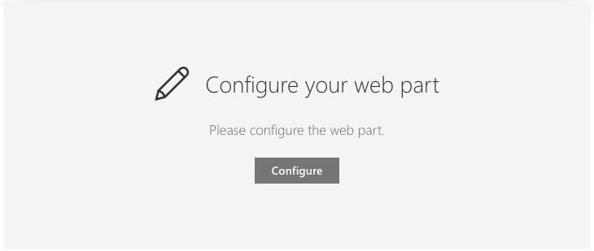
Placeholder
Renders a placeholder which can be used to show a message indicating the web part still has to be configured.

Slide 13
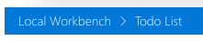
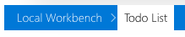
SiteBreadcrumb
Returns a breadcrumb based on the current location.

Slide 14
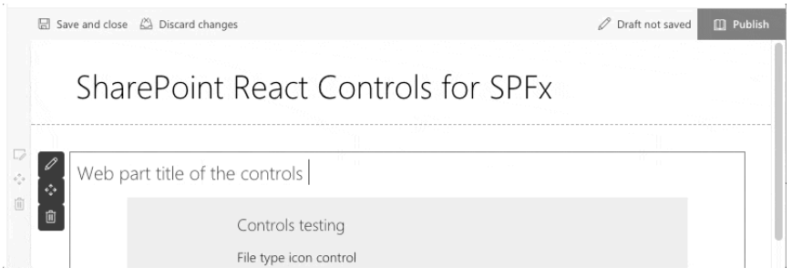
WebPartTitle
Renders a web part title that is editable when the page is in edit mode.

Slide 15
SecurityTrimmedControl
Show or hide components based on user permissions.
Check permissions on the current site
Check permissions on the current list
Check permissions on remote site
Check permissions on remote list / library
Checking permissions on the current site
<SecurityTrimmedControl context={this.props.context}
level={PermissionLevel.currentWeb}
permissions={[SPPermission.viewPages]}>
{/* Specify the components to load when user has the required permissions */}
</SecurityTrimmedControl>

Slide 16
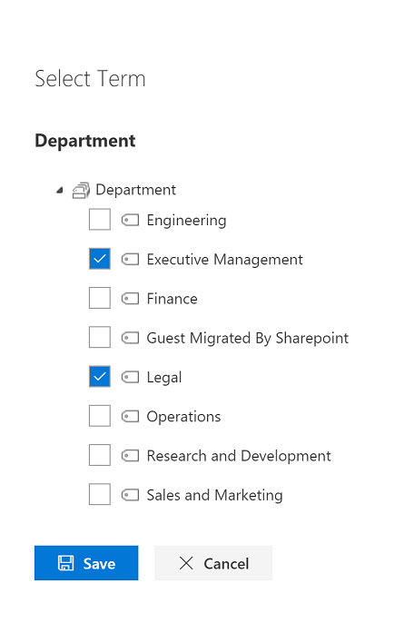
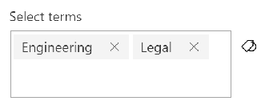
TaxonomyPicker
Allows you to select one or more Terms from a TermSet via its name or TermSet ID.

Slide 17
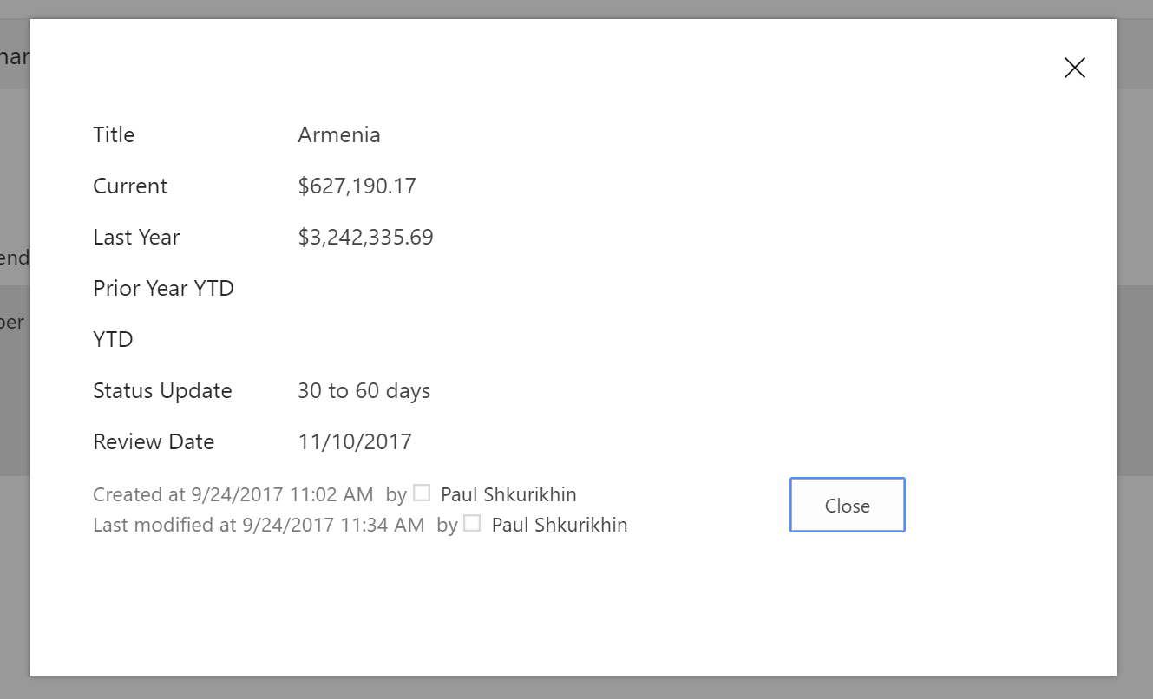
IFrameDialog
Renders a Dialog with an iframe as content.

Slide 18
Field Controls
React controls that can be used in SPFx Field Customizers to provide rendering of the fields similar to out of the box experience.
FieldAttachmentsRenderer
FieldDateRenderer
FieldFileTypeRenderer
FieldLookupRenderer
FieldNameRenderer
FieldTaxonomyRenderer
FieldTextRenderer
FieldTitleRenderer
FieldUrlRenderer
FieldUserRenderer

Slide 19
Reusable property pane controls
Reusable property pane controls for SharePoint Framework solutions

Slide 20
Common project requirements
Use Office UI Fabric
Rich user experience
Used in web part property-pane
“SharePoint-aware”
Very simple to configure and use
Extensible events
Open source
Reusable property-pane controls

Slide 21
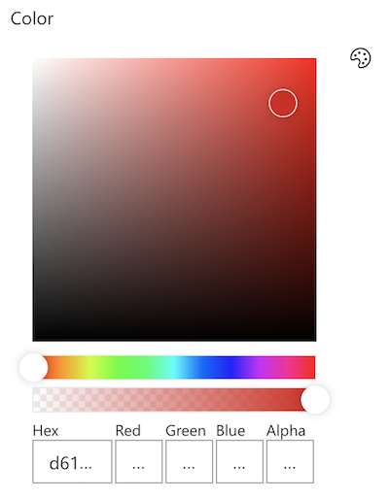
PropertyFieldColorPicker
Generates a color picker that you can use inside the property pane.

Slide 22
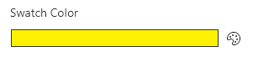
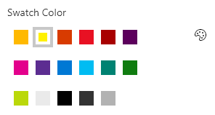
PropertyFieldSwatchColorPicker
generates a swatch color picker that you can use inside the property pane.

Slide 23
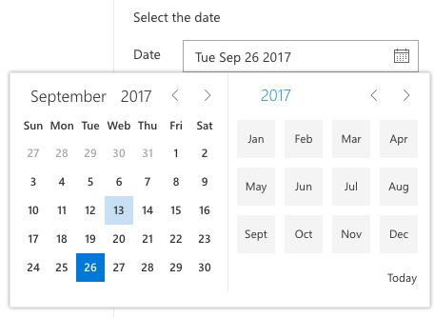
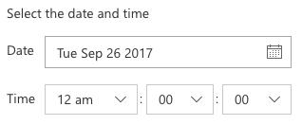
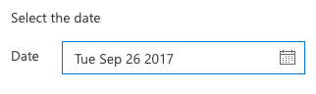
PropertyFieldDateTimePicker
Generates a Date and Time picker field that can be used in the property pane of your SharePoint Framework web parts.
The control can be configured to be date only or date and time.

Slide 24
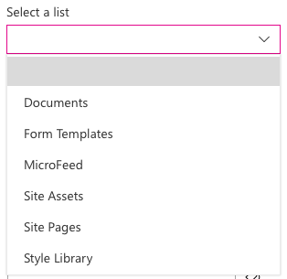
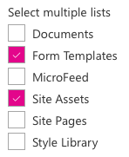
PropertyFieldListPicker
Generates a list picker field that can be used in the property pane of your SharePoint Framework web parts.
The control can be configured as a single or multi-selection list picker.

Slide 25
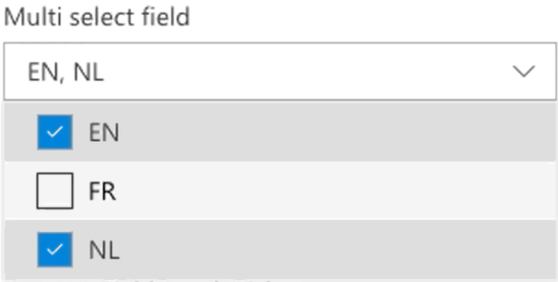
PropertyFieldMultiSelect
Generates a dropdown with the possibility of selecting multiple values.

Slide 26
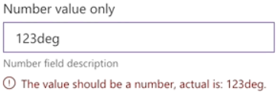
PropertyFieldNumber
Generates an input field for numbers. Text is not allowed as this will result into an invalid input.

Slide 27
PropertyFieldOrder
Generates a list that can be easily reordered using drag and drop and/or arrow buttons.

Slide 28
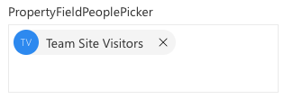
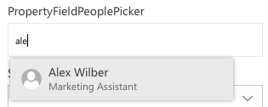
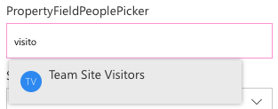
PropertyFieldPeoplePicker
Generates a people / group picker that can be used in the property pane of your SharePoint Framework web parts.

Slide 29
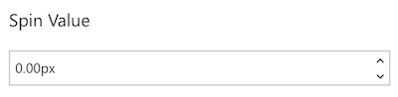
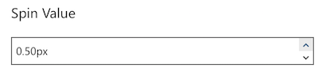
PropertyFieldSpinButton
Generates a spin button which allows the user to incrementally adjust a value in small steps.

Slide 30
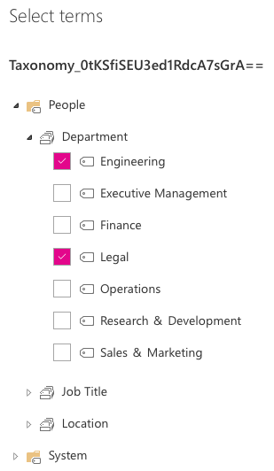
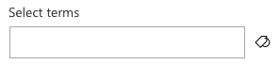
PropertyFieldTermPicker
Generates a term picker that can be used in the property pane of your SharePoint Framework web parts.

Slide 31
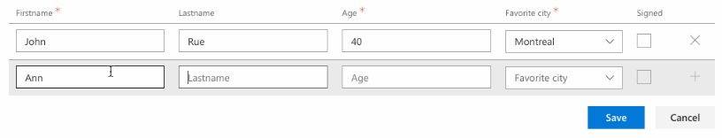
PropertyFieldCollectionData
Gives you the ability to insert a list / collection data which can be used in your web part.

Slide 32
Controls with callout
Standard controls with callout for displaying additional contextual information
PropertyFieldButtonWithCallout
PropertyFieldCheckboxWithCallout
PropertyFieldChoiceGroupWithCallout
PropertyFieldDropDownWithCallout
PropertyFieldLabelWithCallout
PropertyFieldLinkWithCallout
PropertyFieldSliderWithCallout
PropertyFieldTextWithCallout
PropertyFieldToggleWithCallout

Slide 33
Do you still build your SharePoint REST requests as long strings?
If so, this is when you start crying

Slide 34
PnPJS
Fluent JavaScript API for consuming SharePoint and Office 365 REST APIs

Slide 35
Fluent API
SharePoint and Office 365 REST APIs
Type-safe
Very simple to configure and use
Removes the complexity of some operations
Easy to batch requests
Multiple packages, only install what’s required
SharePoint Framework, Node.js, or JavaScript projects
Open source
New: Managed Metadata!
PnPJS

Slide 36
Packages - @pnp/
common
Provides shared functionality across all pnp libraries
config-store
Provides a way to manage configuration within your application
graph
Provides a fluent api for working with Microsoft Graph
logging
Light-weight, subscribable logging framework
nodejs
Provides functionality enabling the @pnp libraries within nodejs
odata
Provides shared odata functionality and base classes
pnpjs
Rollup library of core functionality (mimics sp-pnp-js)
sp
Provides a fluent api for working with SharePoint REST
sp-addinhelpers
Provides functionality for working within SharePoint add-ins
sp-clientsvc Provides based classes used to create a fluent api for working with SharePoint Managed Metadata
sp-taxonomy Provides a fluent api for working with SharePoint Managed Metadata

Slide 37
Get
// get all items
const items = await sp.web.lists.getByTitle("My List").items.get();
// get a specific item by id
sp.web.lists.getByTitle("My List").items.getById(1).get()
// use odata operators for more efficient queries
sp.web.lists.getByTitle("My List").items.select("Title", "Description").top(5).orderBy("Modified", true).get()

Slide 38
Add
// add an item to the list
sp.web.lists.getByTitle("My List").items.add({
Title: "Title",
Description: "Description"
}).then((iar: ItemAddResult) => {
console.log(iar);
});

Slide 39
Batch
let batch = sp.web.createBatch();
list.items.inBatch(batch).add({……}, entityTypeFullName).then(b => {
console.log(b);
});
list.items.inBatch(batch).add({……}, entityTypeFullName).then(b => {
console.log(b);
});
batch.execute().then(d => console.log("Done"));

Slide 40

Web part to list documents from a SharePoint document library
The web part should be configurable to allow the user to
select the source list from the site
Select a managed metadata term to use as filter
List, managed metadata and sample data already available on a test site
Source code:
https://github.com/joelfmrodrigues/demos/tree/master/PnP%20Controls
Demo

Slide 41
Reusable controls (React)
https://github.com/SharePoint/sp-dev-fx-controls-react
https://sharepoint.github.io/sp-dev-fx-controls-react/
Reusable property pane controls (React)
https://github.com/SharePoint/sp-dev-fx-property-controls
https://sharepoint.github.io/sp-dev-fx-property-controls/
PnPJS
https://github.com/pnp/pnp
https://pnp.github.io/pnp/
Web Part samples
https://github.com/SharePoint/sp-dev-fx-webparts
Extension samples
https://github.com/SharePoint/sp-dev-fx-extensions
Resources

Slide 42
Thank you!
Questions?

Slide 43
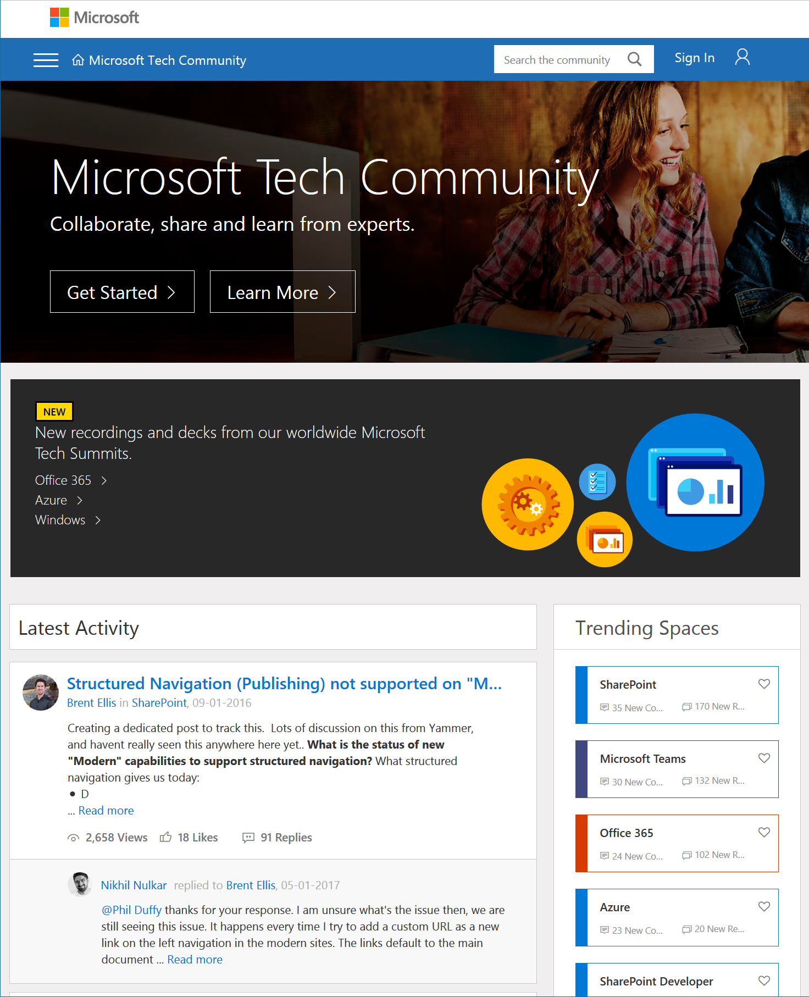
Microsoft Tech Community
techcommunity.microsoft.com
One Microsoft community for IT Pros and tech enthusiasts to learn from experts on Microsoft products
Trusted resource for news, best practices and answers from Microsoft product teams and MVPs
Join today! It’s free – sign in with your Microsoft Account.

Slide 44
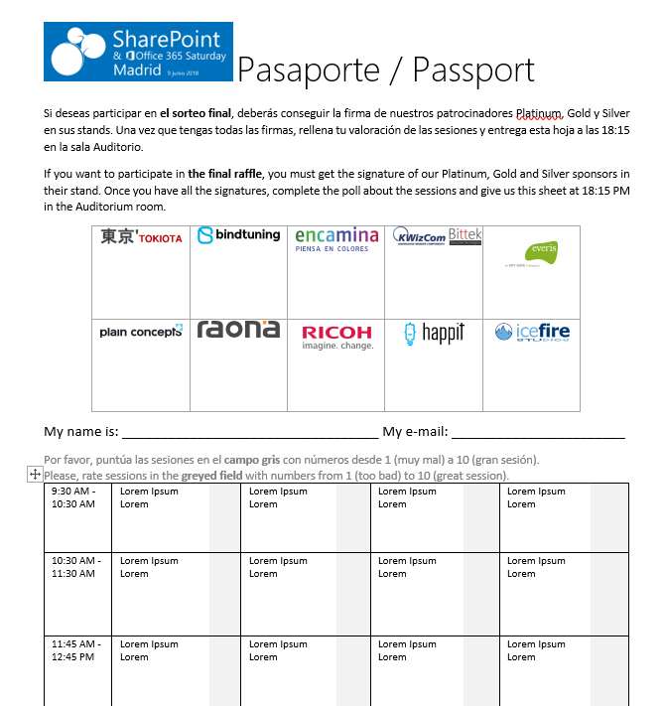




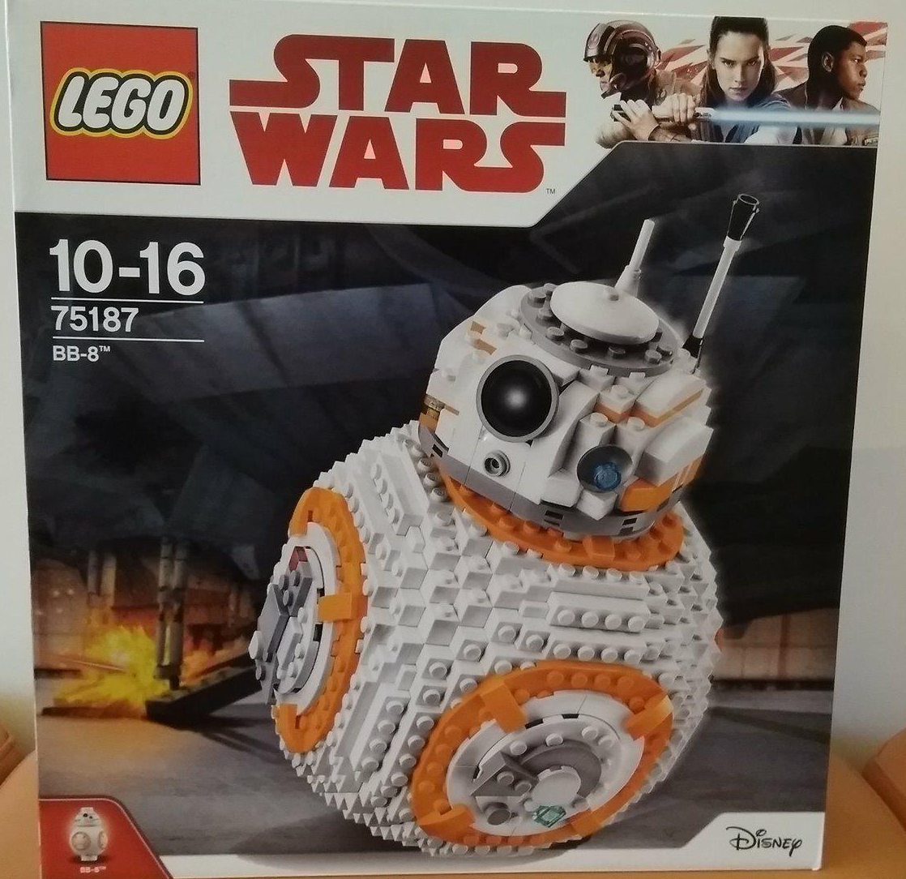


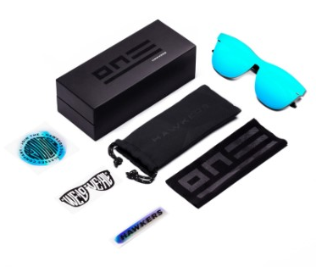








Raffle
Please, fill your SP & Office 365 Saturday Madrid passport if you want to participate.
You can win one of these gifts:
Please, fill your SP & Office 365 Saturday Madrid passport if you want to participate.
You can win one of these gifts:
Odor
Odor@winterfell.com
10
9
2x
2x
8

Slide 45
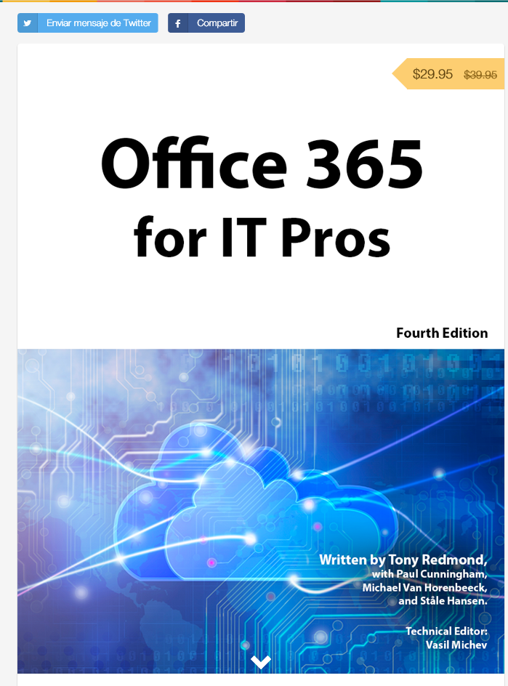
Office 365 for IT Pros
Get a discount of $10 buying the book here: https://gumroad.com/l/O365IT/spsspain

Slide 46
Notes:
This slide is mandatory. Please do not remove and try to use it during Q&A at the end of your session. Thank you!

Slide 47
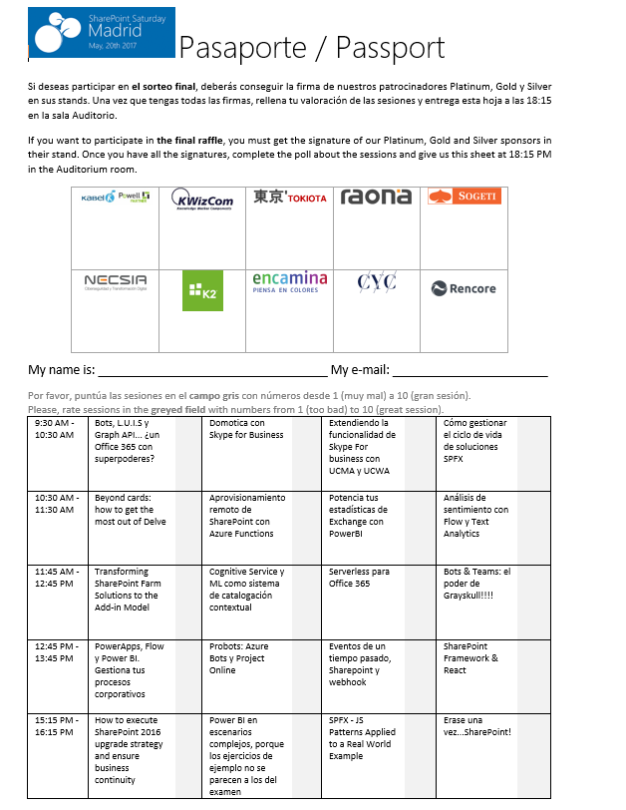
Raffle
Please, fill your SP & Office 365 Saturday Madrid passport if you want to participate.
You can win one of these gifts:
Odor
Odor@winterfell.com
10
9
8

